Slide 1

Introduction
CSCI 265 Lecture 1
By Ariel Avshalom

Slide 2

Welcome to Computer Science Theory
This is a challenging class where you’ll
Write a lot of proofs
Do a lot of boring problems that won’t apply anywhere else
Learn about what makes a computer tick (theoretically)
Have some fun along the way
I plan to stray from our book every once in a while
Seriously though, learning about why a computer works the way it works is important
Becoming mathematically mature (writing up proofs until you can do it in your sleep) is also very useful

Slide 3
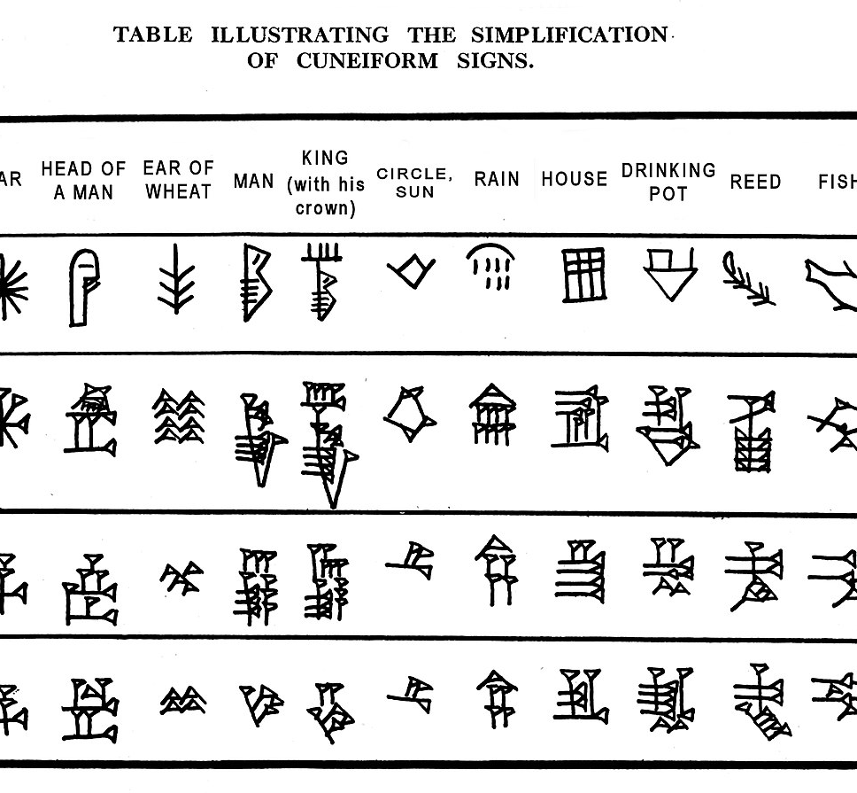
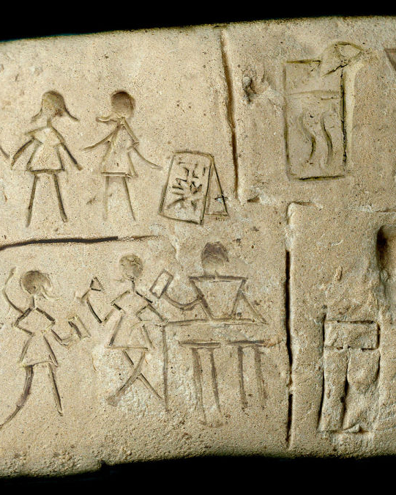
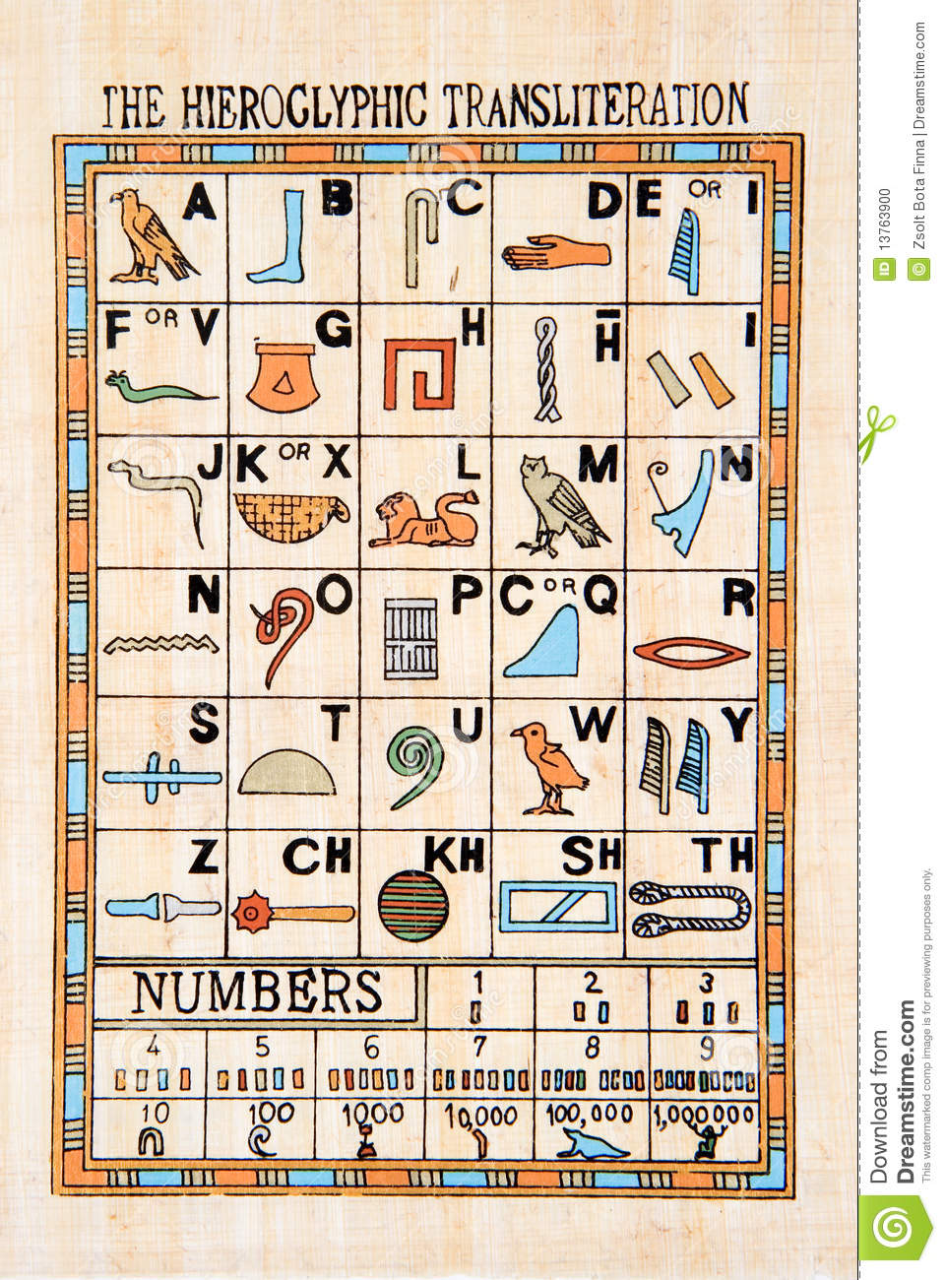
Preliminaries: what is a language?

Slide 4
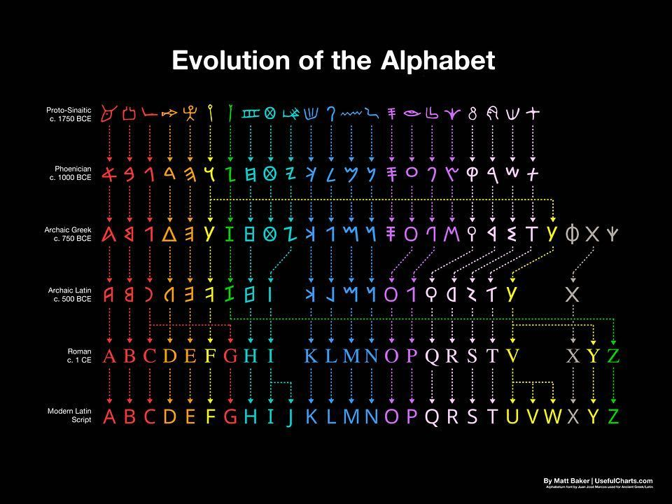
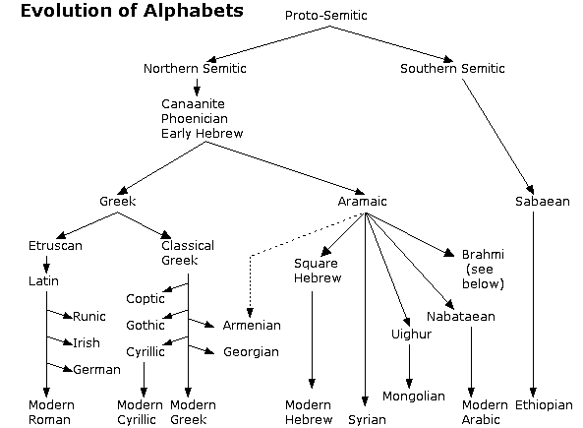
A radical idea:

Slide 5
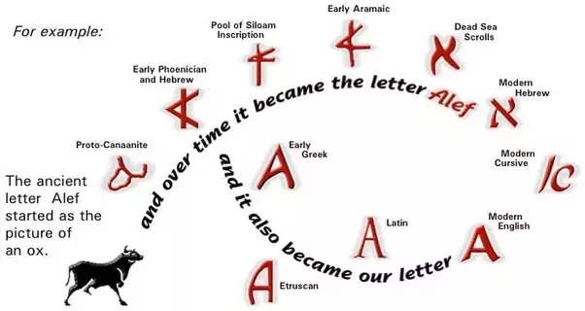
Example

Slide 6
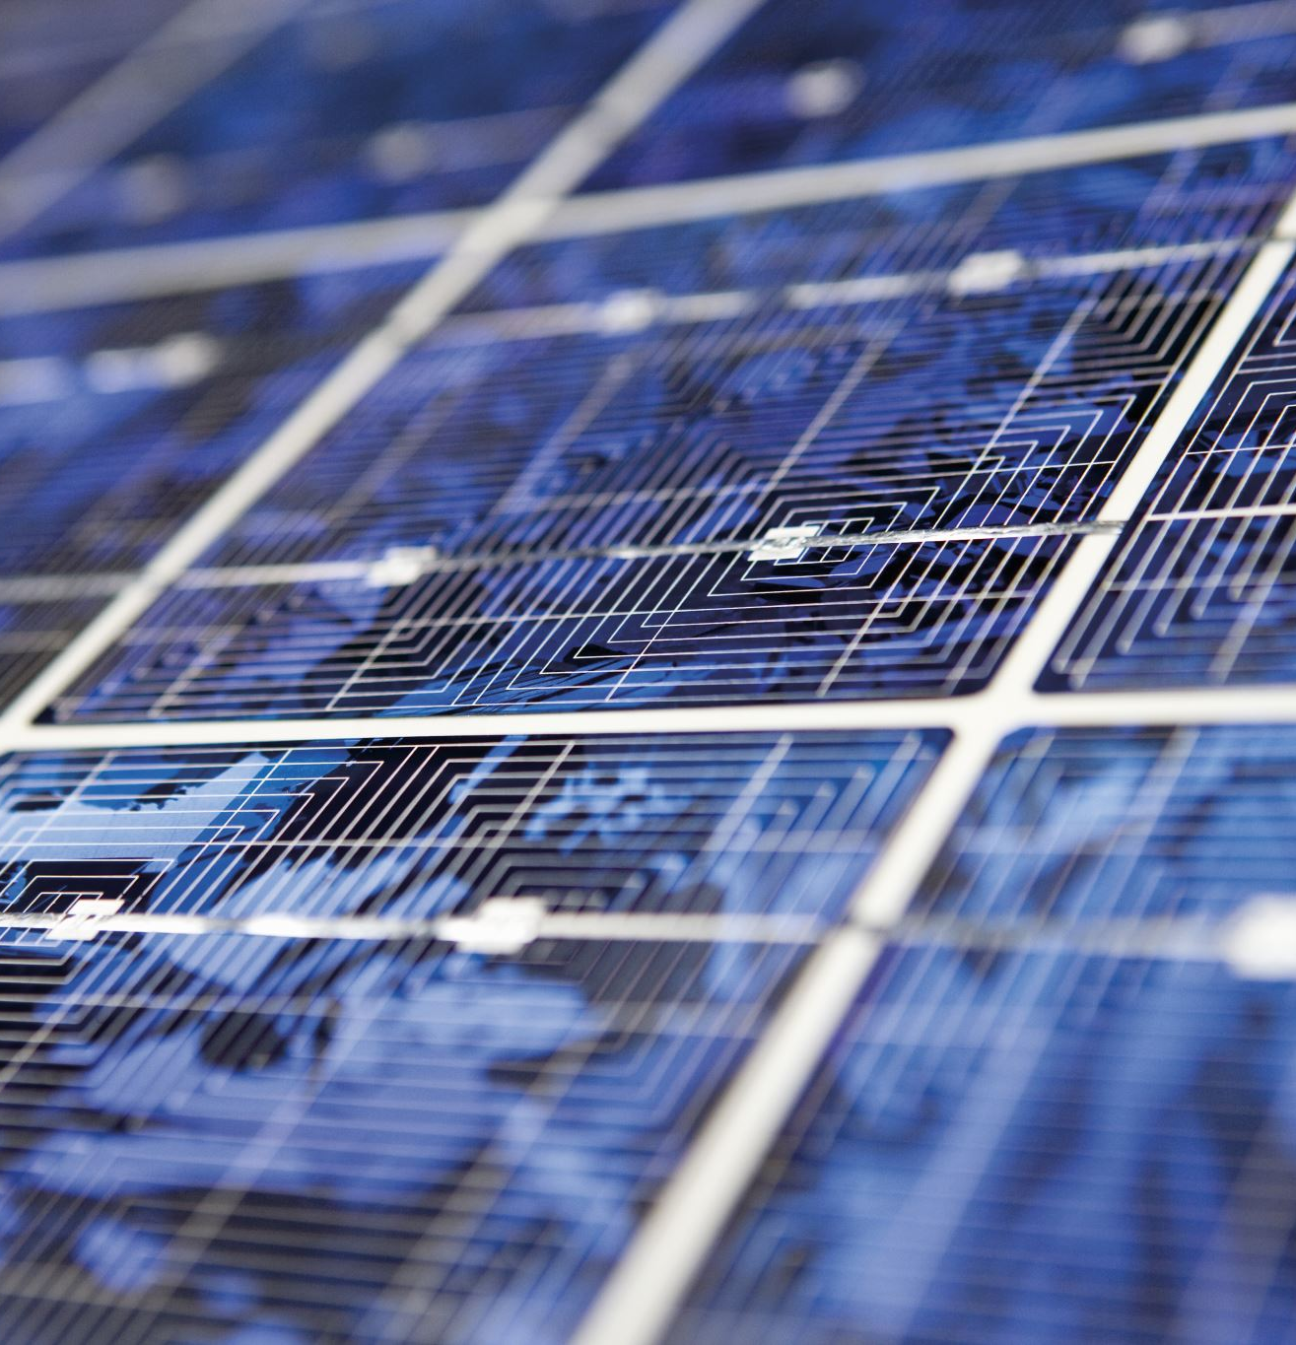
From pictures to words
Humans went from drawing images of
Imagine what would have happened if that ancient human who thought to create words met a tragic end while heading to the patent office?
birds and fish, arms and legs, pottery and tools
to words based on letters
We’d be one sad species

Slide 7


So what’s the point?
Originally, the simplest machines (which we still use today!) simulated this concept of language
These machines are called deterministic finite state automata (DFA) which take as input:
A finite set of states called ($Q$)
An alphabet (Σ)
A transition function ($δ:Q x Σ →Q$)
A start state ($q_{0} ∈ Q$)
A set of accepting states ($F \text{⊆} Q$)
Can you guess what the most confusing part is for students?
Side note, cellular automata are very cool!

Slide 8
Quick example of a function
5 + 5 = 10
Thinking about the above, its sort of like classes in programming, you create the method, namely addition and then you initiate an instance of it like 5 + 5 = 10
Later on in this class we’ll see how Turing Machines calculate something like addition

Slide 9
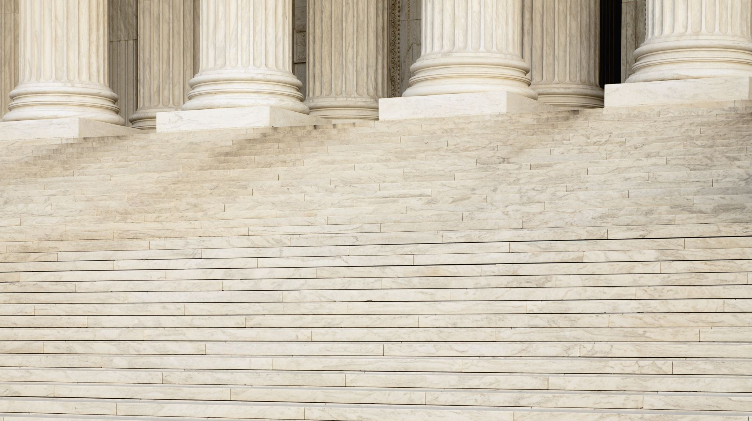

Defining a function
$F: D →R$
The function F acts on some domain D to generate a Range R
Example: the function absolute value {abs} on integers $ℤ$
$abs:\text{ℤ} →\text{ℤ}$ the absolute value function takes any integer and outputs the positive version of it.
For the transition function ($δ:Q x Σ →Q$), delta acts on the set of states ($Q$) crosses by the alphabet ($Σ$) to create a range in the states ($Q$)
This will make much more sense with an example

Slide 10

Soda Pop Machine
Let's take a simple soda machine. If you feed it 35 cents, you get a soda. It would be described as follows:

Slide 11
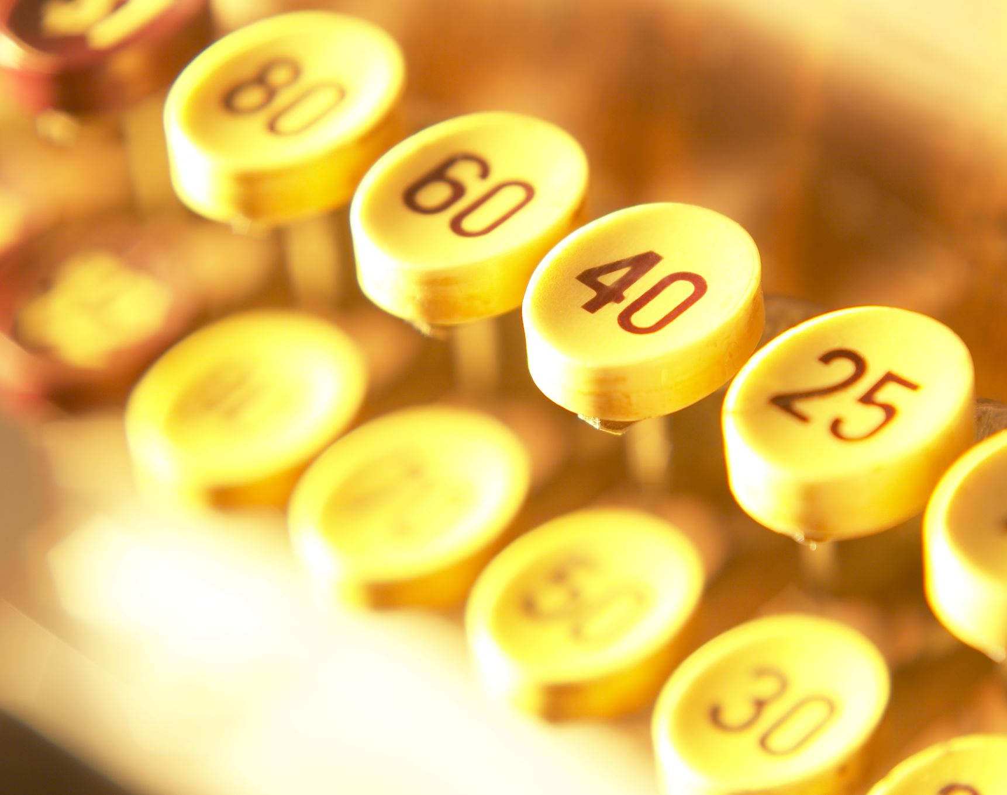
About the above example
The machine described beforehand is one that works on extremely limited memory and is an instance of a finite automata
Most vending machines work in a similar way (albeit with more complex features and embedded memory)

Slide 12


So what can these machines do?
DFAs are mathematical models of limited memory computers
Albeit having extremely limited memory, DFAs can do many things like:
Regular Expressions
Verification of a property in a string (like ends with the letter a)
Text processing
Video game character behavior
NLP
Speech recognition

Slide 13
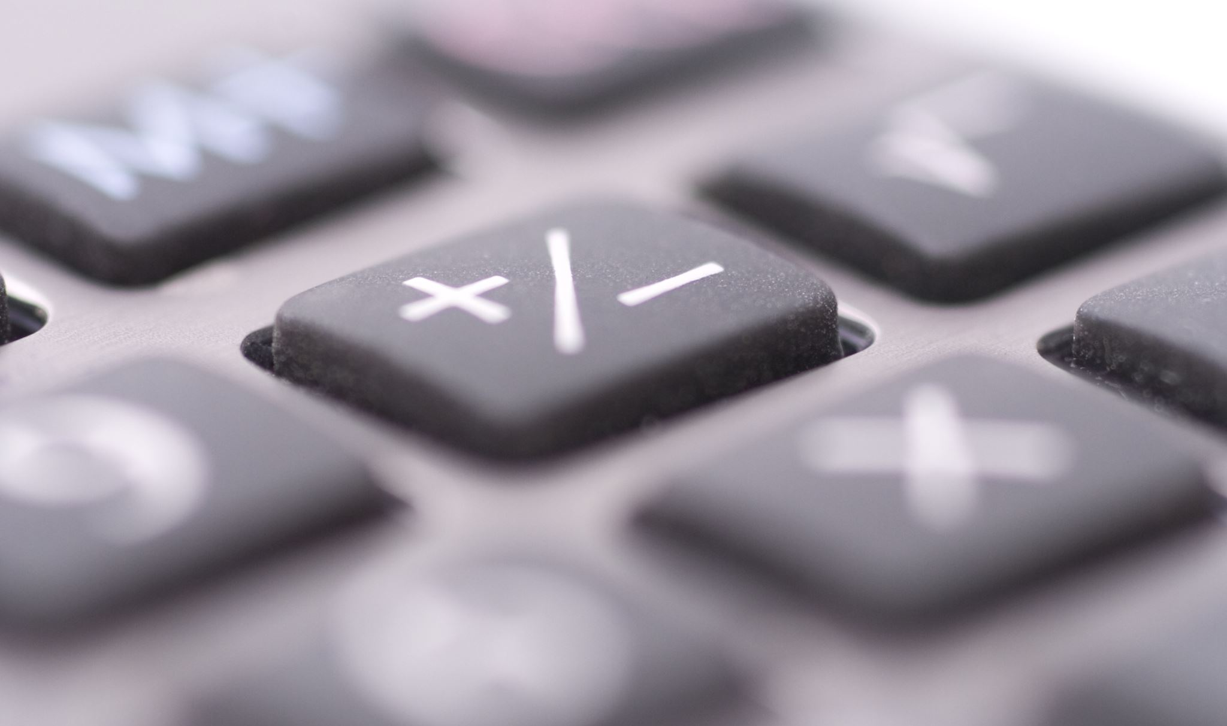
Is that enough?
As we’ll see later in this course, DFAs can be “converted” into other more useful models
But is that enough?
The answer is no, these machines can’t do everything a computer can, but we’ll see many models in this course that do simulate real computer functions

Slide 14
The big picture
Finite automata is where this course begins, but it certainly doesn’t end there
We will cover automata theory, computability theory and complexity theory in this course
Basically, it sort of looks like this:

Slide 15
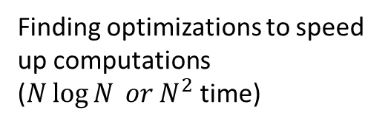
An overview:
Brains and Minds vs Machines
???
Computability Theory
Complexity Theory
Analysis of Algorithms
Formal Language Theory
Harder problems, that could take years to compute
These problems can’t be solved by computers
Finding optimizations to speed up computations ($N\log{N} or N^{2}$ time)
Easily computable like adding up values

Slide 16

Cellular automata

Slide 17
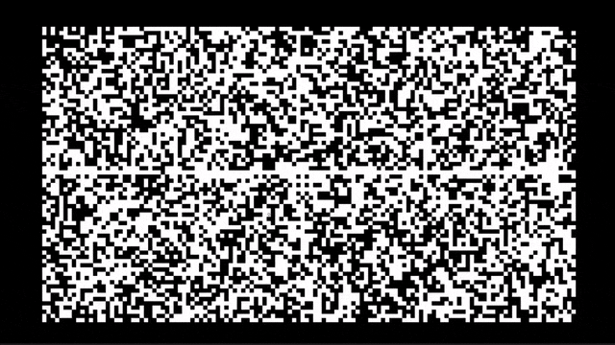
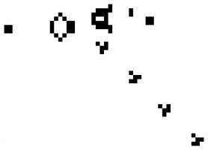

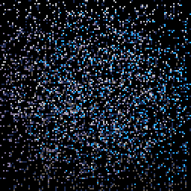
A quick jaunt into interesting territory

Slide 18
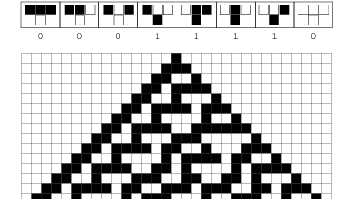
What they are
Cellular automata take simple rules like
They then run those rules for many, many iterations and eventually, interesting patterns start appearing
You can see more about this in Stephen Wolfram’s book on the subject and here
Watch the first 3 minutes of this Ted Talk to understand the image

Slide 19
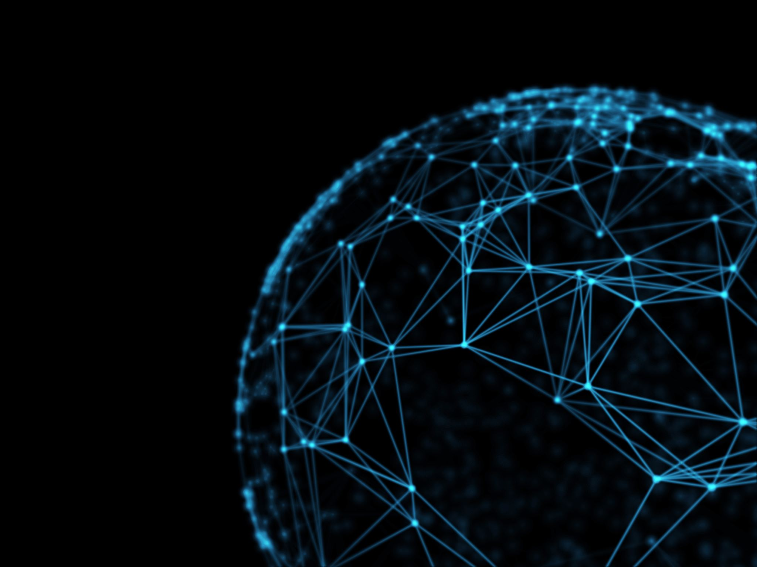
Why mention cellular automata?
As we’ll see in the next lecture that a language is called regular is some finite automaton recognizes it
A language is a set of strings that are accepted by a machine
According to Wolfram’s Computational Theory of Cellular Automata, some classes of cellular automata correspond to regular languages
That means that these classes can be recognized by some set of finite automatons

